Slide 1
Deployment & MLOps Essentials
Building Production-Ready ML Systems
CI/CD • Docker • Monitoring • Drift Detection

Slide 2
Table of Content
Module 1: MLOps & Deployment Fundamentals
Module 2: CI/CD Pipelines for ML
Module 3: Docker Containerization
Module 4: Monitoring & Drift Detection
Module 5: Production Deployment Strategies

Slide 3
Most ML models fail after deployment, not during training
Real-world challenges:
Changing data
Scale
Reliability
Reproducibility

Slide 4
Why MLOps Matters
Traditional ML development faces critical challenges:
Lack of team collaboration & communication
Manual deployment causing errors and delays
Poor version tracking of models and data
No monitoring for performance degradation

Slide 5
MLOps Workflow
Data Collection
Gather & preprocess data, manage versions
Model Development
Build & experiment, track metrics
Training
Validate & evaluate models
Deployment
Production CI/CD pipelines
Monitoring
Track performance & drift
Retraining
Auto-refresh on decline

Slide 6
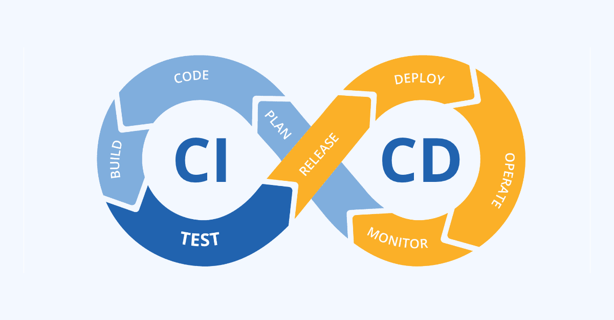
Continuous Integration & Deployment (CI/CD)
What makes ML pipelines different from traditional software?
Depend on Code, Data, Features & Model Artifacts
Components change frequently
Require structured validation at each step
Need automated testing & deployment

Slide 7
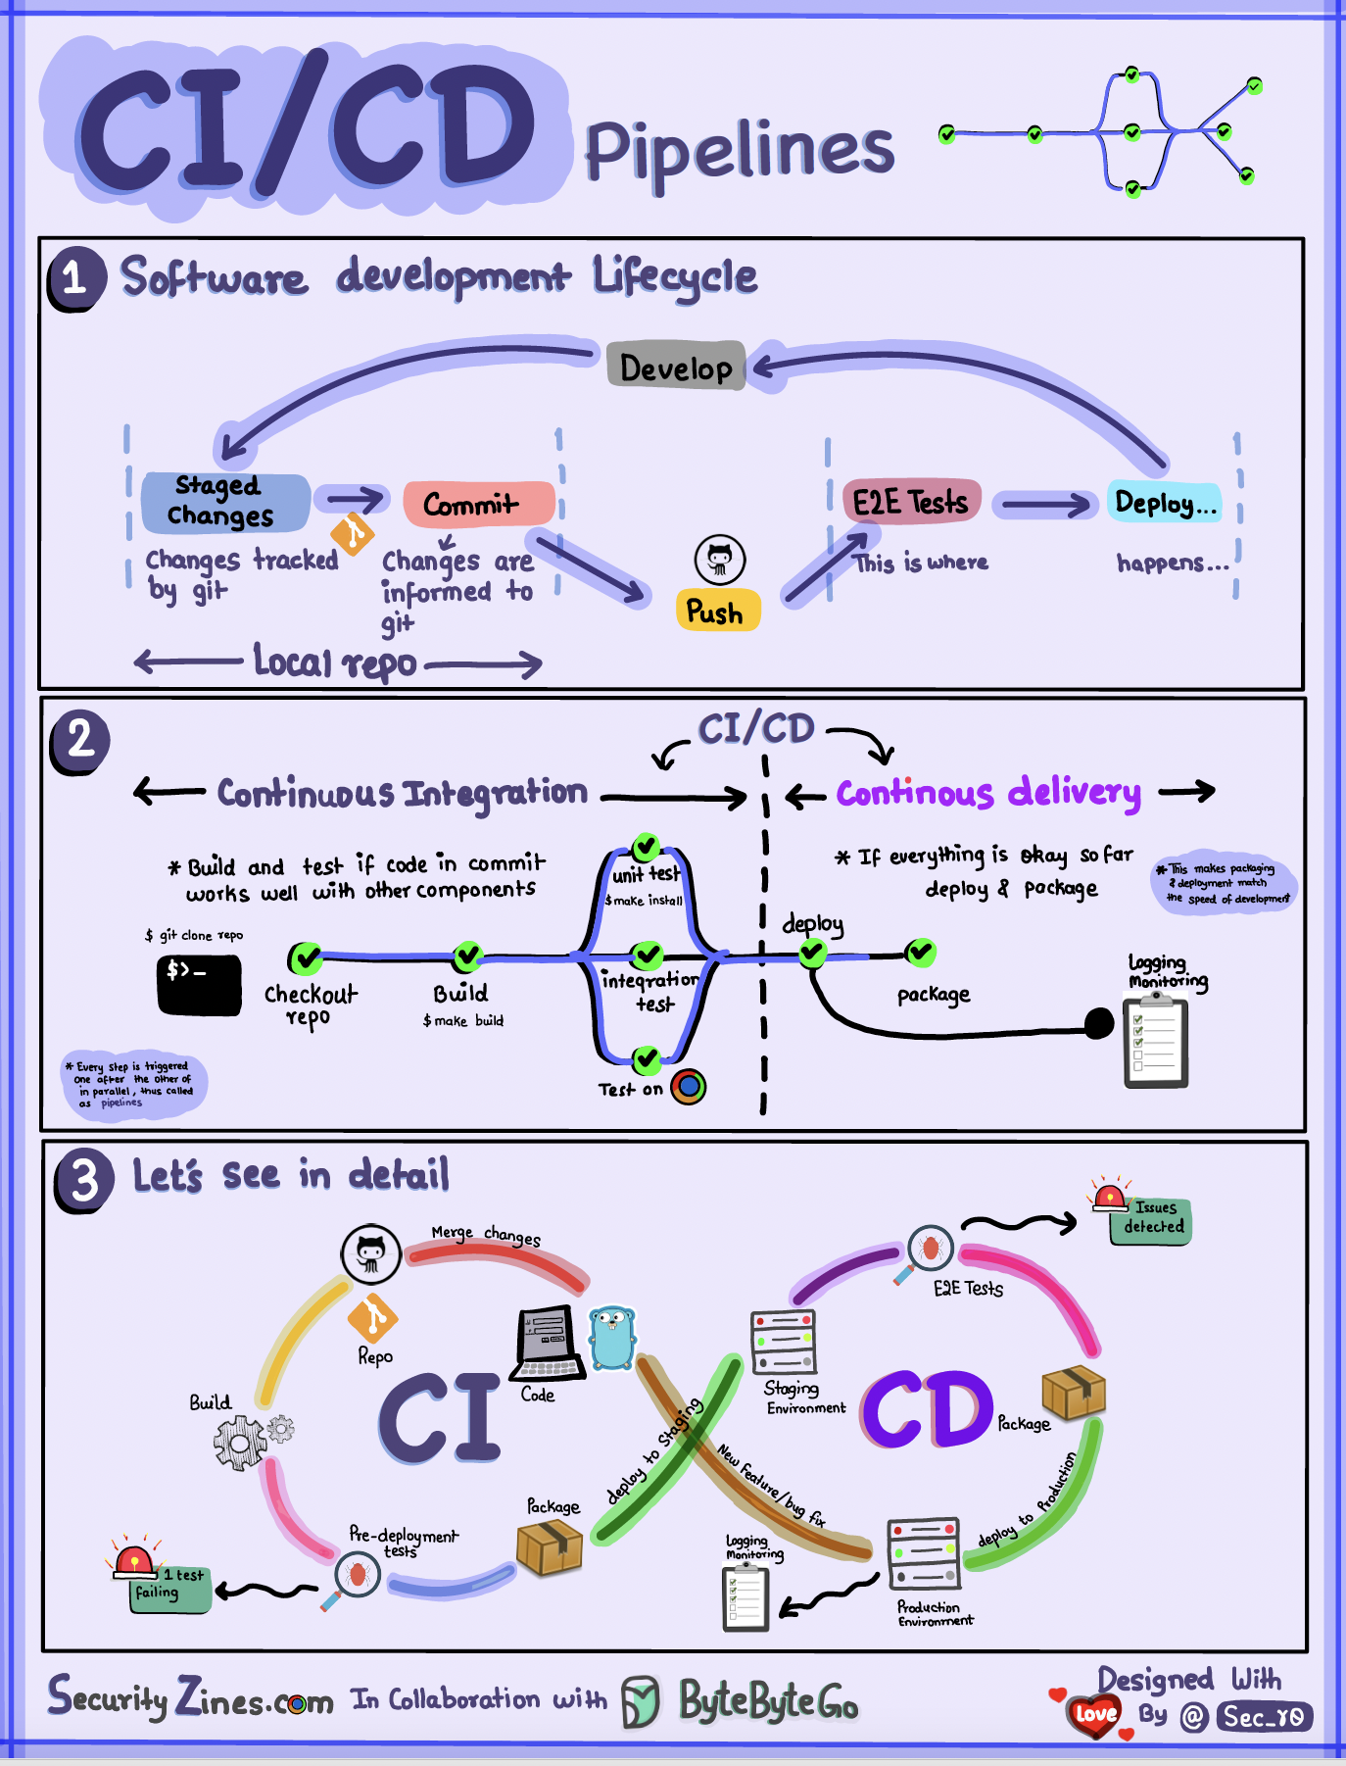

Slide 8
Continuous Integration (CI)
CI focuses on validating ML changes:
Data Validation: detect schema & anomalies
Feature Validation: ensure consistency
Model Training: automatic retraining
Unit & Integration Tests: validate pipelines
Model Evaluation: accuracy, F1, ROC-AUC checks
Output: Validated model artifact in registry

Slide 9
Continuous Deployment (CD)
CD automates safe model releases:
Model Registry (catalog of trained models): automatic version selection
Safe Strategies: Blue-Green, Canary, Shadow
Auto-Monitoring: drift, latency, accuracy
Rollback: automatic revert on failure

Slide 10
What Actually Happens in an ML CI/CD Pipeline
1) Developer pushes code or new data to GitHub
2) CI pipeline starts: data validation + unit tests
3) Model is trained automatically on server
4) Model is evaluated against previous version
5) If metrics are better → model is registered
6) CD pipeline builds Docker image and deploys model
7) Monitoring starts in production (latency, accuracy, drift)

Slide 11
Safe Deployment Strategies
Blue-Green
Two identical envs, switch traffic when stable
Canary Release
Release to small user portion first
Shadow Deploy
New model runs parallel, no impact

Slide 12
How CI/CD Improves ML Lifecycle
Efficiency: Automates training, testing, deployment
Reliability: Prevents bad models from production
Scalability: Manage multiple models easily
Reproducibility: Track all versions & changes

Slide 13
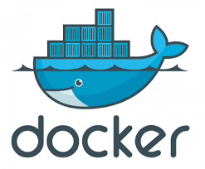
Docker: Containerization Platform
Docker packages your application + dependencies in containers for seamless deployment across environments.
Key Benefits:
Consistent behavior across dev, test, production
Lightweight & fast compared to VMs
Isolates dependencies & prevents conflicts

Slide 14
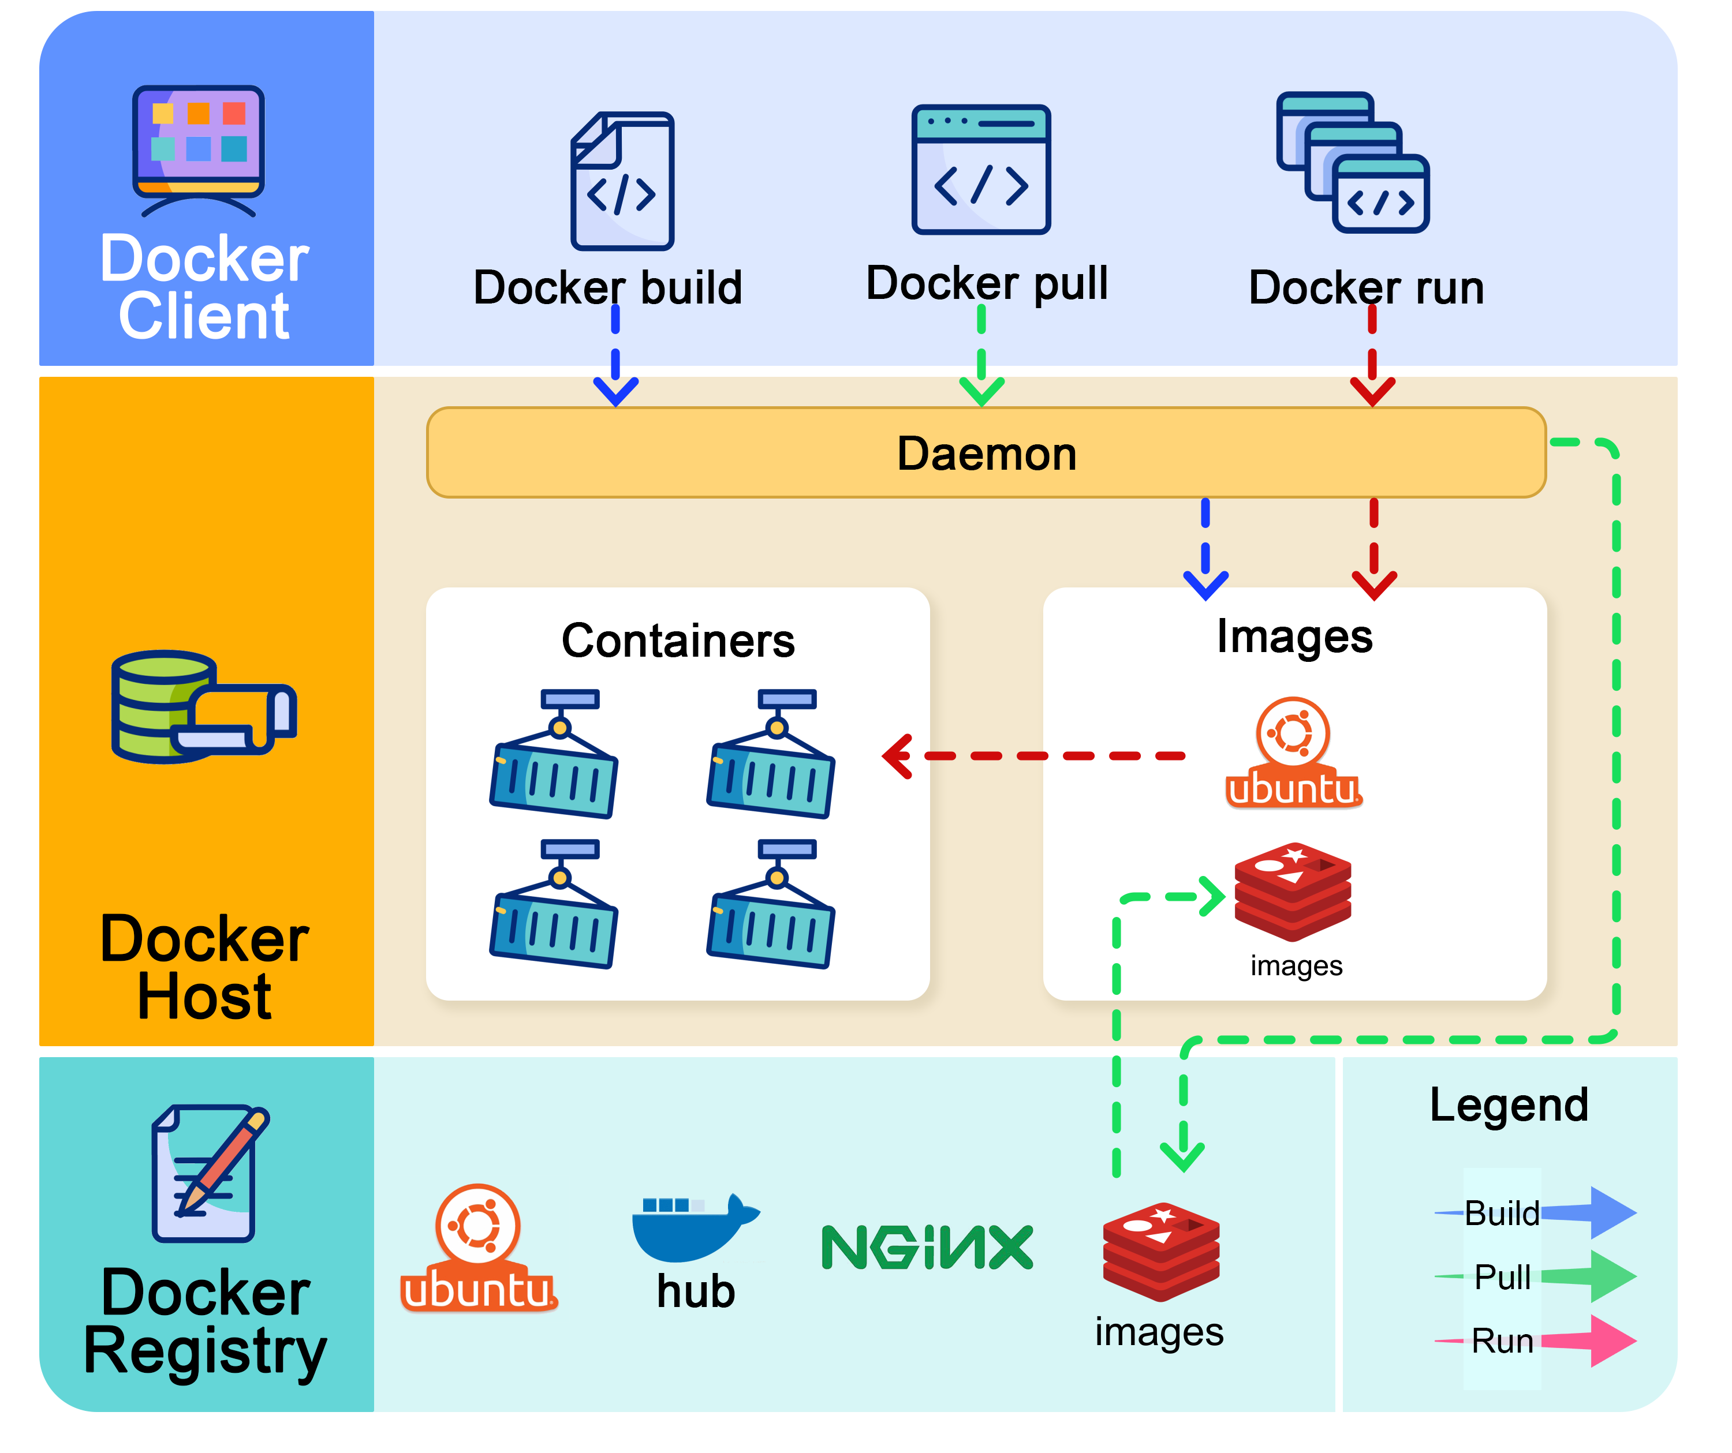
Docker Architecture
Docker Client: Sends commands (build, run, pull)
Docker Daemon: Processes requests via REST API
Docker Registry (Hub): Stores & distributes images

Slide 15
Core Docker Components
Images: Read-only templates with all dependencies
Dockerfile: Text file with instructions to build image
Containers: Runtime instances of images
Registry: Storage for public/private repositories

Slide 16
What Goes Inside a Dockerfile (Conceptual)
Base image: e.g., python:3.9-slim
Install dependencies: numpy, pandas, sklearn, flask, etc.
Copy model file and API code into container
Expose a port (e.g., 5000)
Command to start API: python app.py
Result: one portable image that runs the same everywhere

Slide 17
Containerization Advantages
Speed
Lightweight & fast boot-up process
Portability
Works on Linux, Windows, Mac, cloud
Density
More containers per host than VMs

Slide 18
Building a Dockerfile
Essential Commands:
Base image (ubuntu, python, etc)
Execute commands during build
Copy files into container
Document ports
Default command to run

Slide 19
Monitoring in Production
What to Monitor:
Model Accuracy & Performance Metrics
Prediction Latency & Throughput
Data Quality & Anomalies
System Health (CPU, Memory, Disk)

Slide 20
Data Drift Detection
Data Drift: Input data changes over time, model becomes obsolete
Monitor feature distributions regularly
Detect statistical shifts early
Compare training vs production data
Trigger automatic retraining when drift detected

Slide 21
Concept Drift Detection
Concept Drift: Relationship between features & target changes
Monitor prediction quality decline
Compare expected vs actual outcomes
Detect performance degradation early
Implement automated retraining pipelines

Slide 22
Data Drift vs Concept Drift
Data Drift: Input data distribution changes (e.g., age, salary ranges change)
Model trained on old data but production data looks different
Concept Drift: Relationship between input and output changes
Example: Customer behavior changes over time
Both cause silent accuracy drop if not monitored

Slide 23
Drift Detection Methods
Statistical Tests
KL divergence, Kolmogorov-Smirnov tests
Performance Monitoring
Track accuracy over time windows
Automated Alerts
Trigger retraining thresholds

Slide 24
Automated Retraining Pipeline
Keep models fresh without manual intervention:
Trigger retraining when drift detected
Use new data automatically
Validate before deployment
Rollback if performance drops

Slide 25
How Drift is Monitored in Real Systems
Store recent production data and predictions
Compare new data distribution with training data
Run statistical tests (KS test, KL divergence, PSI, etc.)
Track live accuracy if ground truth is available
If drift crosses threshold → send alert or trigger retraining

Slide 26
End-to-End MLOps Reference Architecture
Data Source → Data Validation → Training Pipeline
Experiment Tracking (MLflow / W&B) stores metrics
Best model → Model Registry
Docker builds inference service
CI/CD deploys to server / cloud / Kubernetes
Monitoring checks performance + drift → triggers retraining

Slide 27
MLOps Best Practices
Version control code, data, & models
Containerize with Docker
Automate CI/CD pipelines
Implement comprehensive monitoring
Document data & feature lineage

Slide 28
Scaling ML in Production
Use Kubernetes for container orchestration
Implement load balancing for predictions
Monitor resource utilization continuously
Auto-scale based on demand
Manage multiple model versions seamlessly

Slide 29
Key Performance Indicators
Model Metrics
Accuracy, F1, precision, recall
System Metrics
Latency, throughput, uptime
Business Metrics
Deployment frequency, time-to-market

